Slide 1
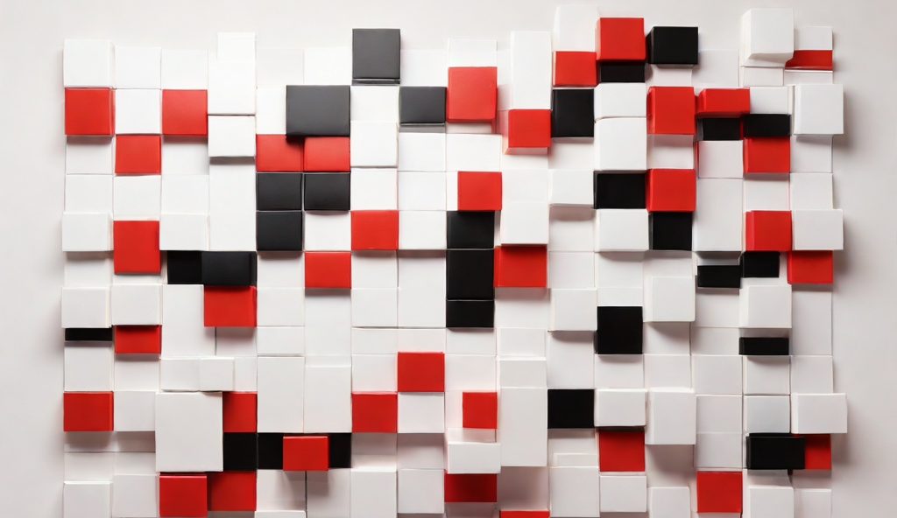
ZKLife
ZK-Enhanced On-Chain AI Gaming for Game of Life

Slide 2

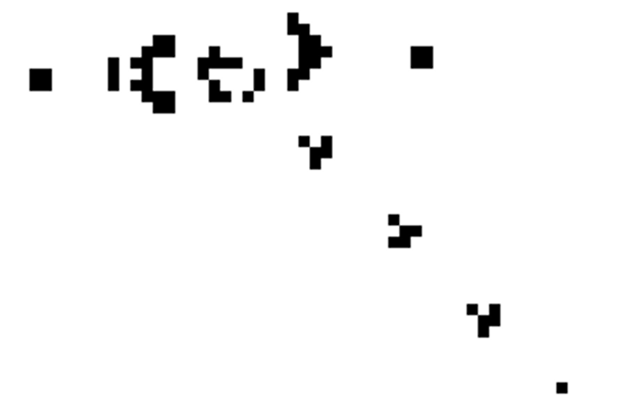
What is Game of Life?
created by John Horton Conway in 1970
a zero-player cellular automaton simulating evolution from an initial state.
It‘s Turing complete!

Slide 3






Still Lifes
Block
Beehive
Loaf
Boat
Tub
What makes this game so much fun?
Oscillators
Blinker
Toad
Beacon
Pulsar
Penta-decathlon
Spaceships
Glider
Light-weight
spaceship(LWSS)
Middle-weight spaceship(MWSS)
Heavy-weight spaceship(HWSS)

Slide 4


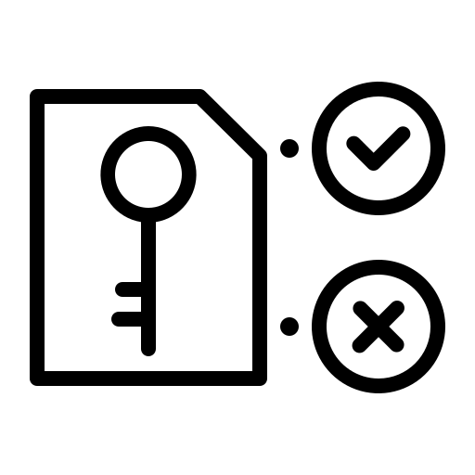
Keyword:
Onchain AI Game
Zero Knowledge Proof

Slide 5
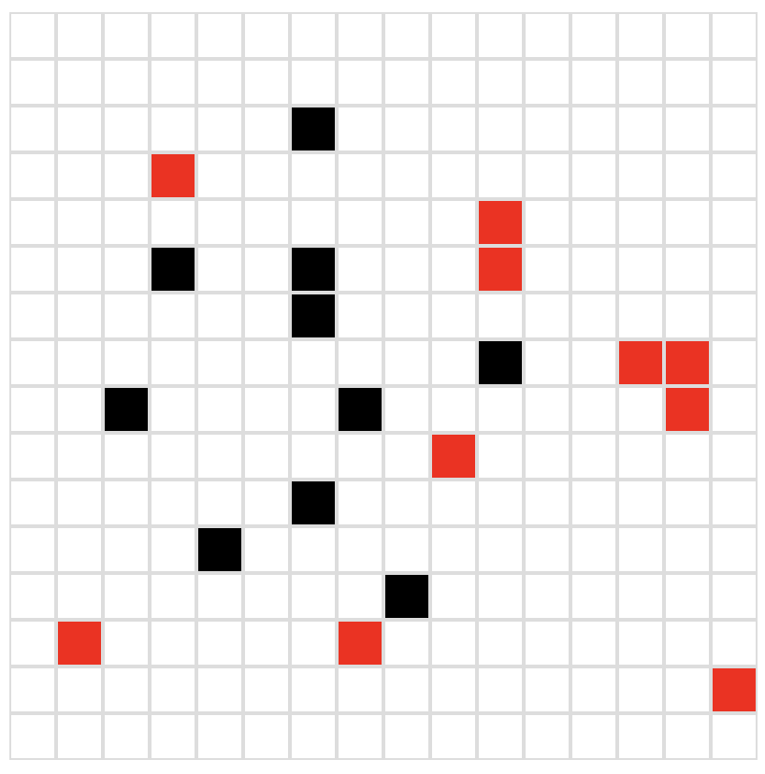

Keywords: Onchain AI Game
Game of Life
Defeat AI and then mint glorious NFTs！
AI

Slide 6
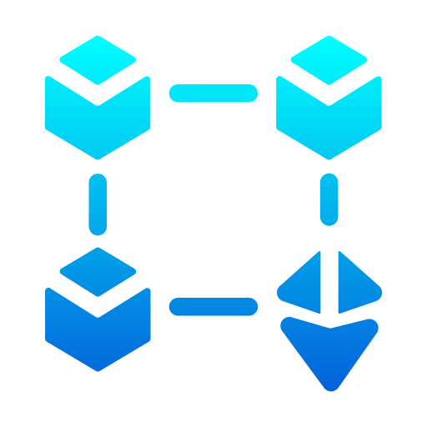
Keywords: Zero Knowledge Proof
Blockchain
zkp
Zk Coprocessor

Slide 7




Keywords: Zero Knowledge Proof
Step 1: User play the game and emit initial parameters in the contract
3. Emit events
Smart contract
blockchain
2. Parameters passing (game init state)
1. Connect to the wallet & Put in initial parameters
4. Get block id
User
Frontend
Step 2: Conduct the logic of the game and generate zkp
4. Using zkgraph-api to get a zkp
blockchain
1. Control zkgraph, pulling event data
3. Run the game code and render in frontend
2. Read events data to get initial parameters
Frontend
zkgraph
Step 3: mint the winner a NFT
2. NFT
1. Mint an NFT and send it to the winner
User
Smart contract
Frontend

